Slide 1
Data Types

Slide 2
What We’ll Cover
Data types
Categorical
Ordinal
Numerical

Slide 3
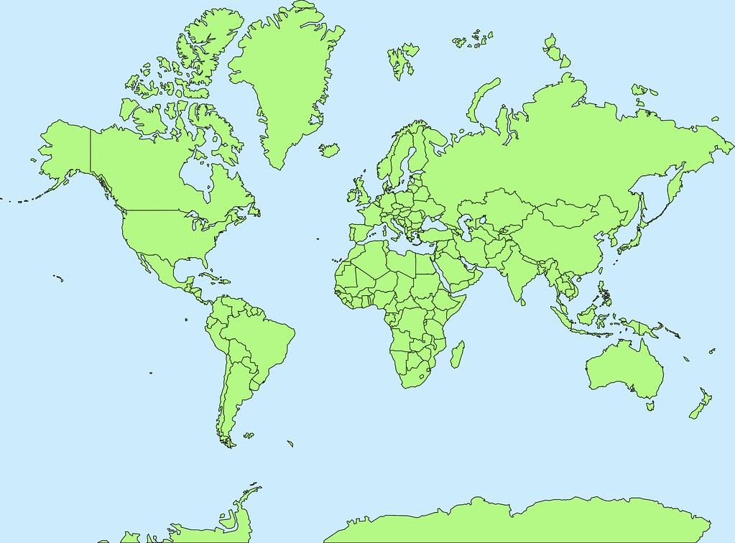
Categorical/Nominal Data
Qualitative
Impossible to compare mathematically
Describes characteristics
Gender
Ethnicity
Nationality
Notes:
Photo: https://www.flickr.com/photos/107442568@N08/12547327134

Slide 4

Ordinal Data
In between Numerical+Nominal
Can compare mathematically
Although definitions are still vague (e.g. your rating vs mine)
Examples
Ratings
Descriptive scales (e.g. cold, lukewarm, hot)
Mild
Hot
Notes:
Photo: https://p0.piqsels.com/preview/75/886/497/4480j35547m45663a3pm5fmsvd.jpg

Slide 5
Ordinal Data
In between Numerical+Nominal
Can compare mathematically
Although definitions are still vague (e.g. your rating vs mine)
Examples
Ratings
Descriptive scales (e.g. cold, lukewarm, hot)
Mild
Hot
Notes:
Photo: https://p0.piqsels.com/preview/75/886/497/4480j35547m45663a3pm5fmsvd.jpg

Slide 6


Correlation Coefficient

Slide 7
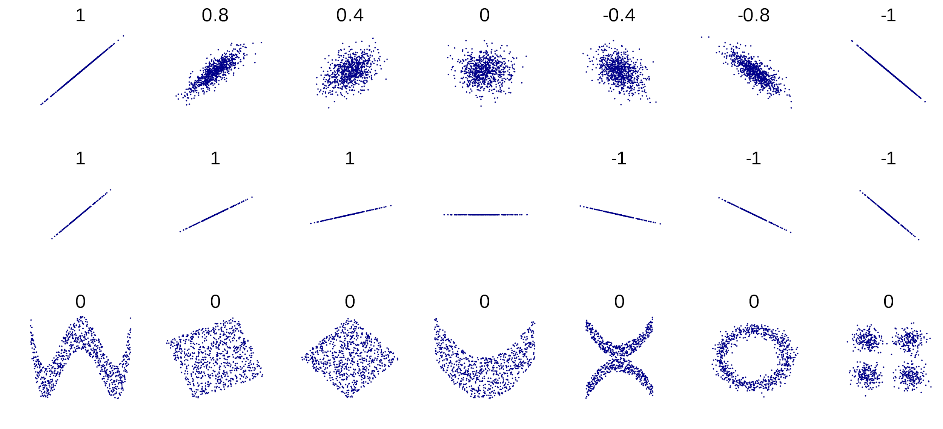
Correlation Coefficient
Linear
Pearon’s
Non-Linear
RMSE

Slide 8
Causation and Correlation

Slide 9
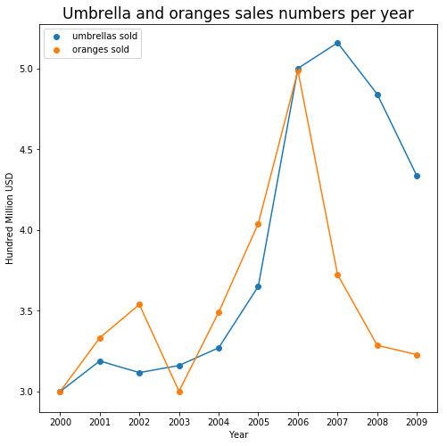
Causation and Correlation
Correlation
Causation
Cause and effect
Signal
Noise
Notes:
Spurious Correlations

Slide 10
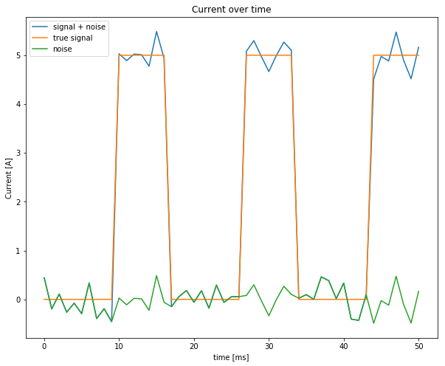
Causation and Correlation
Correlation
Causation
Cause and effect
Signal
Noise
Notes:
Spurious Correlations

Slide 11
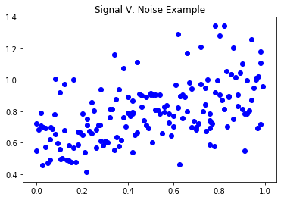
Causation and Correlation
Correlation
Causation
Cause and effect
Signal
Noise
Notes:
Spurious Correlations

Slide 12
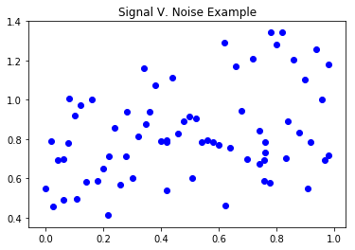
Causation and Correlation
Correlation
Causation
Cause and effect
Signal
Noise
Notes:
Spurious Correlations

Slide 13
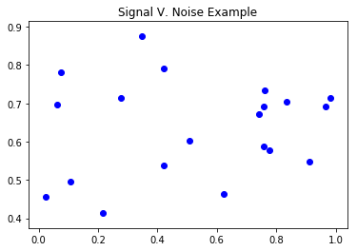
Causation and Correlation
Correlation
Causation
Cause and effect
Signal
Noise
Notes:
Spurious Correlations

